Slide 1
Direct Connection to a Raspberry Pi
Zero
From:
https://desertbot.io/blog/headless-pi-zero-ssh-access-over-usb-windows

Slide 2
Introductory Note
The following presentation was originally prepared for use with a Pi Zero. They also work as written for the following other models:
Raspberry Pi A
Raspberry Pi A+
Raspberry Pi Compute Module.
All of these models feature a microUSB data port combined with the power port.
Other models do not have such a port. However, they have an ethernet port. I will give you separate instructions for such models.
These directions only work for a Windows computer. For a Mac, you will need a Raspberry Pi 3 or 4.

Slide 3
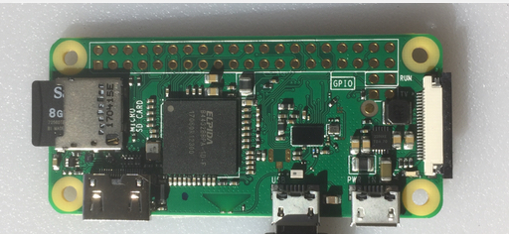
A Rasberry Pi Zero

Slide 4
How to Access a Raspberry Pi Zero
When you first get a Pi Zero the big question is -- how do you access it? You can get a powered USB hub, USB keyboard, USB mouse and HDMI adapter. Or you can just plug it into your computer directly and access it over USB using ssh.
This presentation shows you how to do the last option.

Slide 5
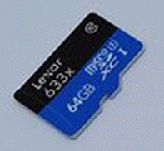
Hardware Needed
MicroSD card, with an SD card adapter.
(A Raspberry Pi does not have a hard drive, but has a MicroSD card slot. So the operating system has to be installed on a MicroSD card.)
A computer with an SD card slot.
(This computer will install the OS)
A microUSB cable.
(This will power the Raspberry Pi, and will connect the Pi to the computer.)

Slide 6
Software Tools Needed
Raspbian Lite, found at www.raspberrypi.org/downloads/.
balenaEtcher, found at www.balena.io/etcher/
Notepad++, found at notepad-plus-plus.org.
Bonjour Print Services, found at support.apple.com/kb/DL999?locale=en_US

Slide 7
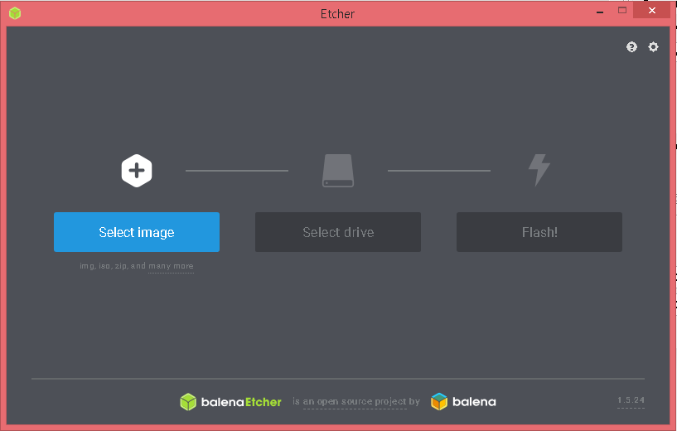
Installing Raspbian Lite
Put the SD card into an adapter and plug it into your computer
Run Etcher and select the Raspbian zip file
Select the SD card drive
Finally, click Flash to write the Raspbian image to the SD card
You'll see a progress bar. Once complete, the utility will automatically unmount the SD card.

Slide 8
Editing the Raspbian Lite Image
Pull the SD card out and plug it back in again
  NOTE: Windows gets confused when you plug in a Raspbian image and it may try to get you to format it - always hit Cancel
The SD card should appear in File Explorer as a drive named "boot"
Open the SD card and explore the contents in File Explorer
You should now see the contents of the root of your Raspbian boot image

Slide 9
Enable ssh
To enable ssh by default you have to place an empty filed named ssh. (no extension) in the root of the card.
Run Notepad++
In a new file put in one space and nothing more
Call the file ssh. and save it to the root of the MicroSD card.
Close the file, but keep Notepad++ open.

Slide 10
Editing config.txt File
In the root folder of the SD card, open config.txt in Notepad++.
Append this line to the bottom of that file:
dtoverlay=dwc2
Save the file.

Slide 11
Editing cmdline.txt File
In the root folder of the SD card, open cmdline.txt in Notepad++.
Find the text rootwait, and append this text leaving only one space between rootwait and the new text :
modules-load=dwc2,g_ether
Make sure that there is only one space after this new text. The entire file must remain on a single line.
Save the file.
Close Notepad++.

Slide 12
Connecting to a Windows Computer
You will need to install Bonjour Print Services so that you can connect to the Raspberry Pi without knowing its IP address.

Slide 13
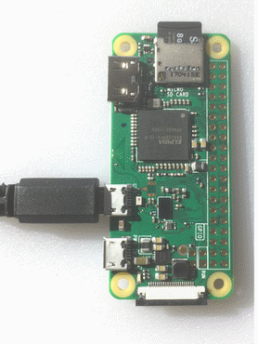
Boot the Pi Zero
Eject the MicroSD card from the main computer, and put it into the Pi Zero.
Plug the Micro-USB cable into the port closest to the center of the card
Plug the other end into a USB port on your computer
The power light on the Pi Zero will start blinking. Wait several seconds after it stops blinking.

Slide 14
Connecting to Raspberry Pi Via SSH
Open a Command Prompt and enter
ssh pi@raspberrypi.local
If this is the first time you have connected to this Raspberry Pi, SSH may give you a warning. Just respond "yes".
The Raspberry Pi will respond asking for a password. The default password is "raspberry".

